Slide 1
Miniproject 4: Loan Predictions
Niklas Bergen
September 3, 2021
Notes:
Simon’s feedback:
- Liked the Outline and the simplicity of the Objective slide
- IDEs/Packages are less important; classifier types are more important.
- Could use correlation matrix to explain Urban importance
Try to compare model accuracy to some kind of baseline (from Garrett: “based on the data there are 614 entries, 422 approved so 68.7% approval rate”)
Keep track of how metrics change when adding/removing features
Zain’s comments on Miniproject 3:
Analyse dataset for bias (e.g. more male data than female) and pick equal amount of data
Anurag’s comments on Miniproject 2:
Real-life data science projects typically are at least 3 months
No code at all, or screenshots from Jupyter labs
Don’t make your audience work for your visualizations
Evaluate presentation from this perspective: “you are an owner of a company, and somebody presents you this presentation”.
Focus on the big picture and the business problems you are solving. (How does the business earn money?)
Practice talking to non-technical audience (how to explain API to a 5 year-old)

Slide 2
Outline
Objective
Workflow
Methods Used
Results
Challenges

Slide 3





Objective
Automate loan approval process
Self-employed
High Loan, Short Term
High Income
No credit history
Notes:
Not only automate it, but deploy to cloud.
Approval/denial factors are hypotheses!

Slide 4
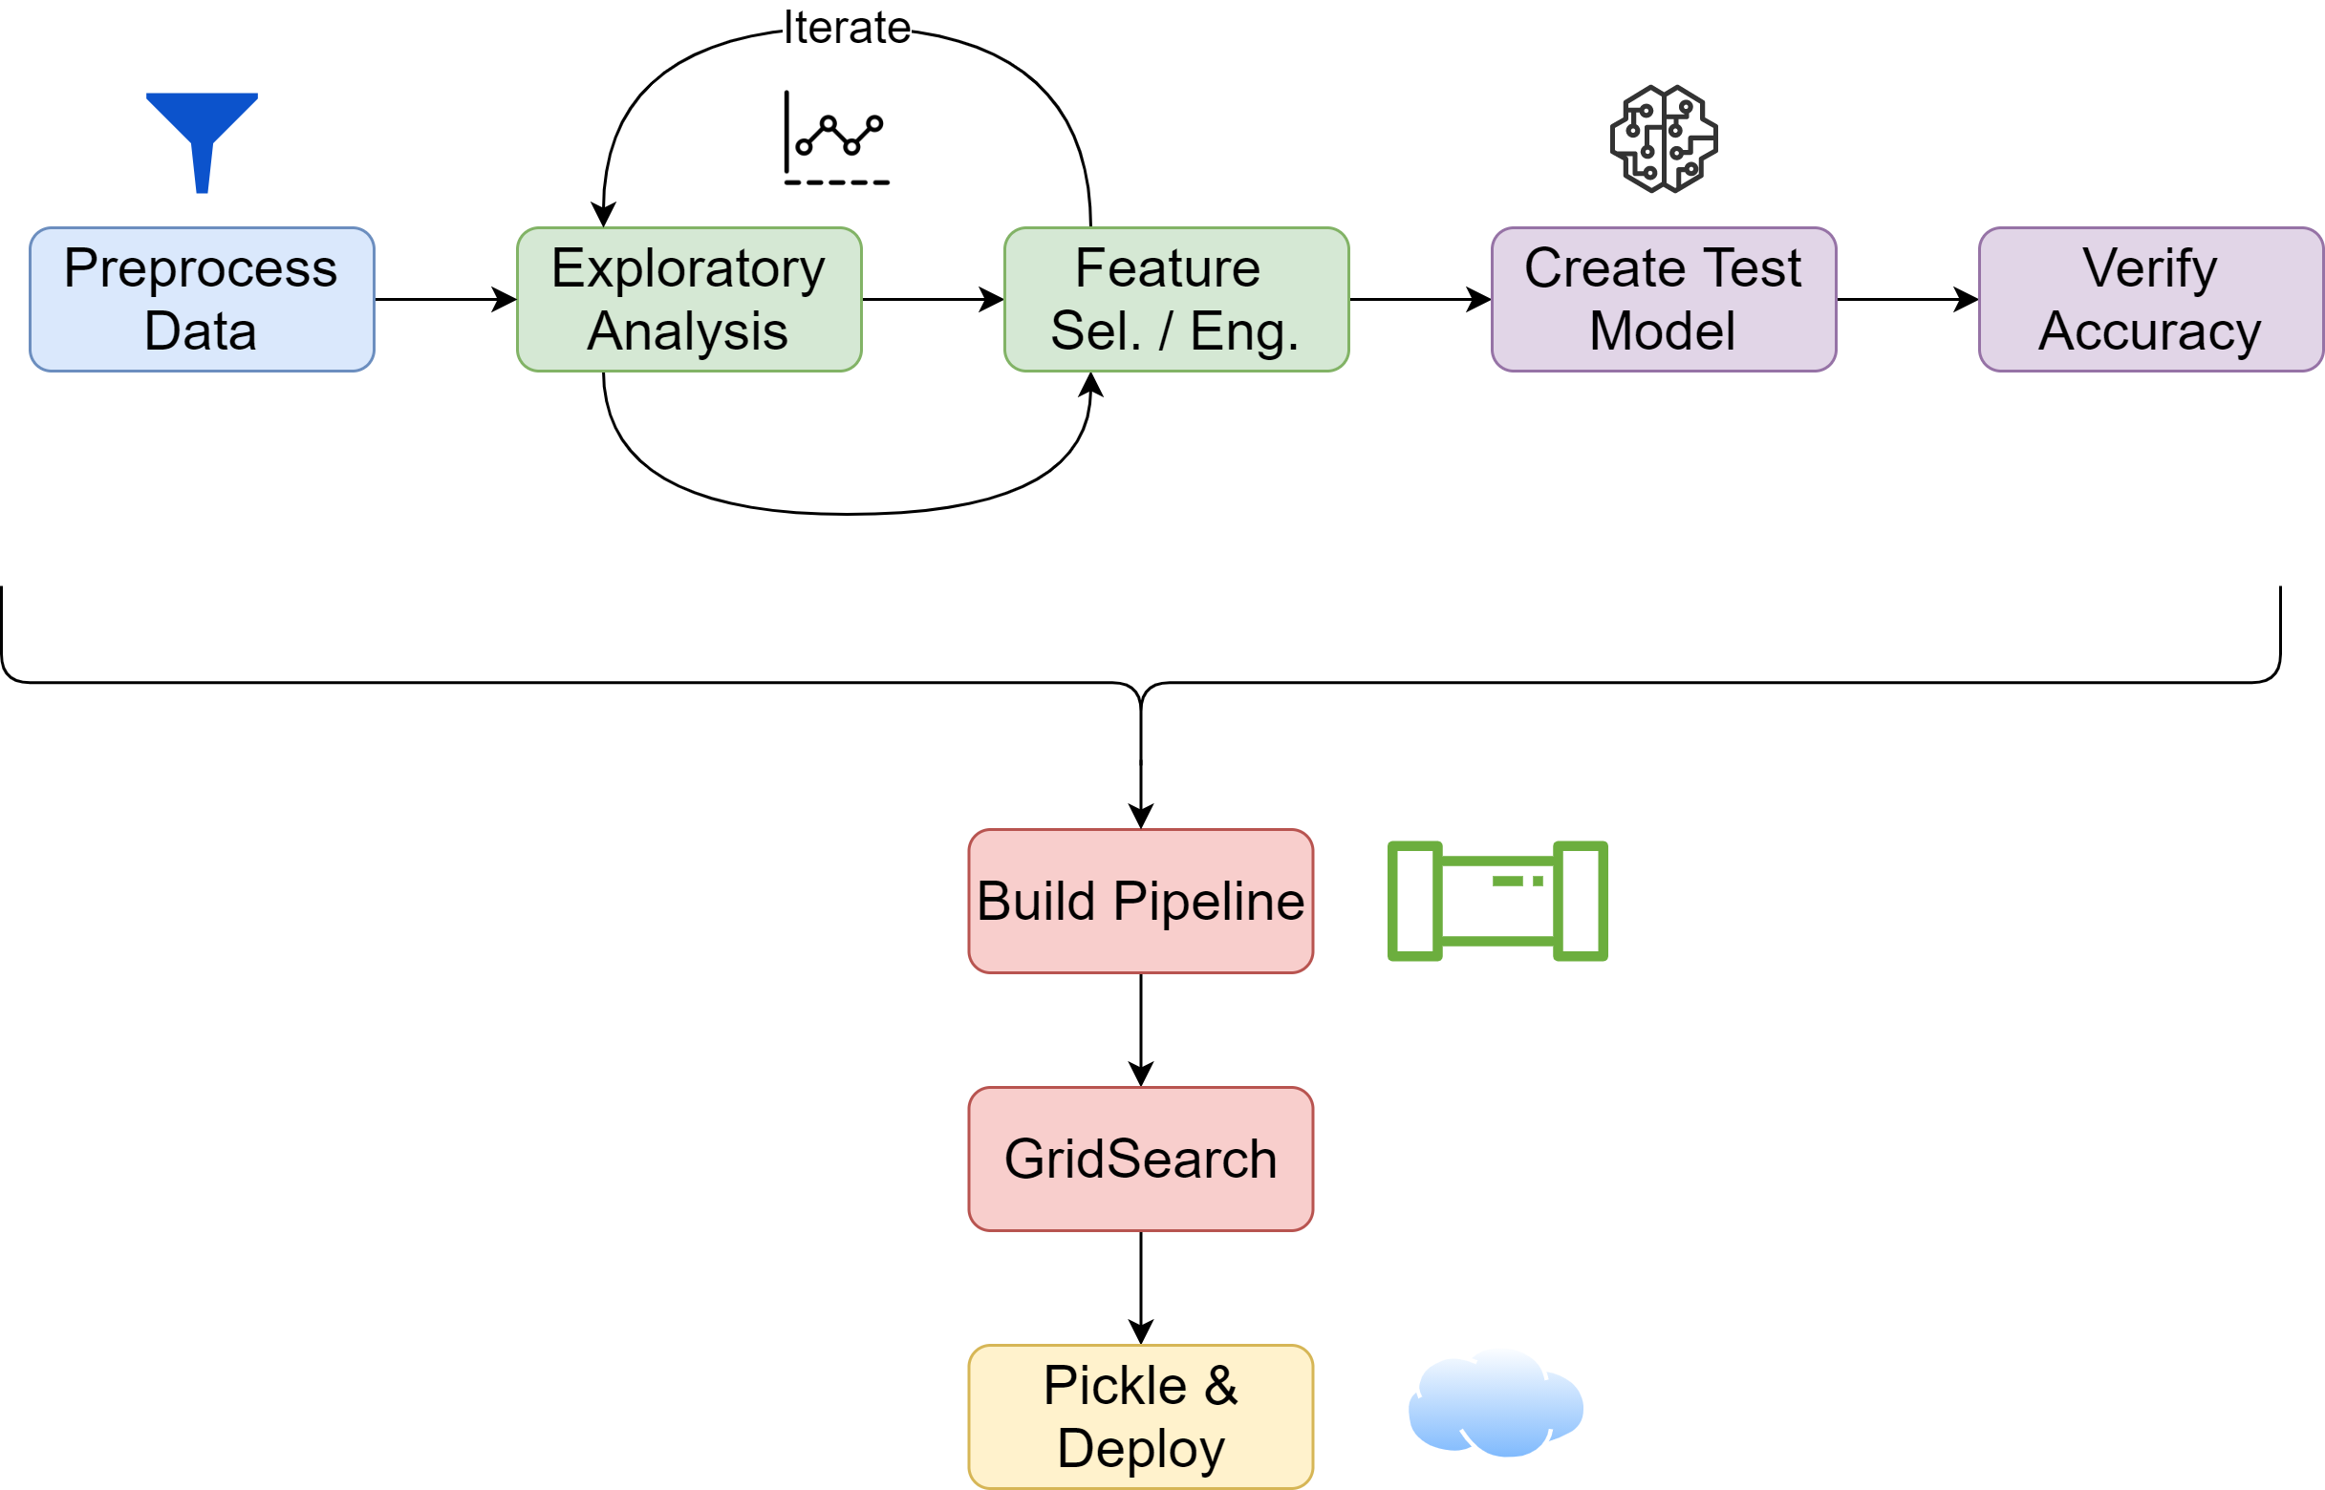
Workflow

Slide 5





Methods Used
RidgeClassifier
RandomForestClassifier
GradientBoostingClassifier
Primary Tools
Packages

Slide 6
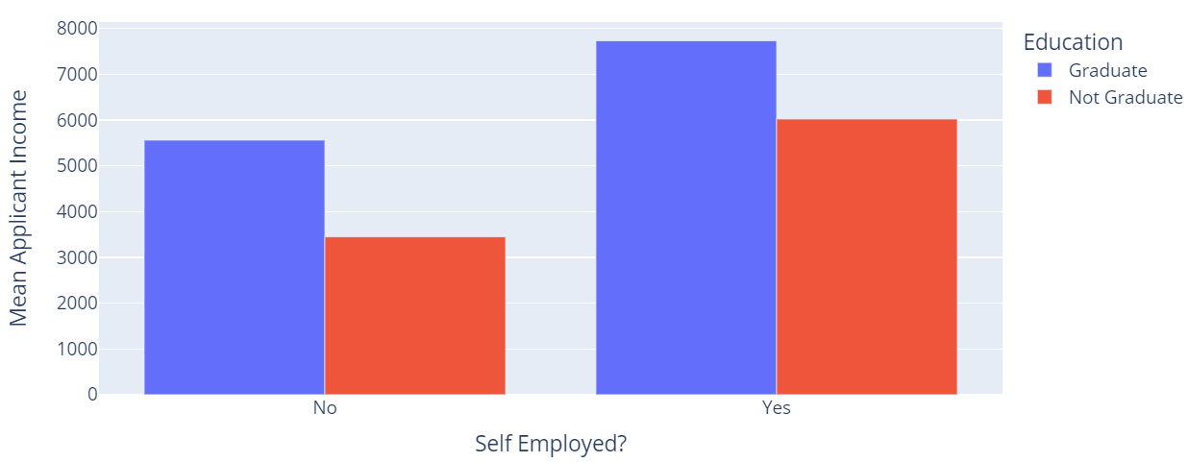
Results
Exploratory analysis:
Insights
Certain factors have a high influence on applicant income
Applicants should be required to provide more information

Slide 7
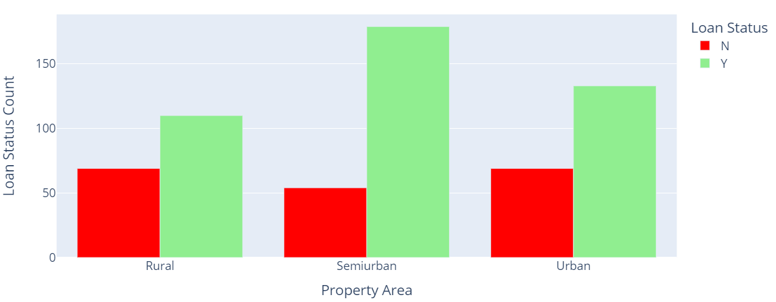
Results
Exploratory analysis:
Insights
Urban and semiurban applicants are highly favored
Other factors are more important for rural applicants
Notes:
Other factors are more important for rural applicants since the denials and approvals are closer in number.

Slide 8
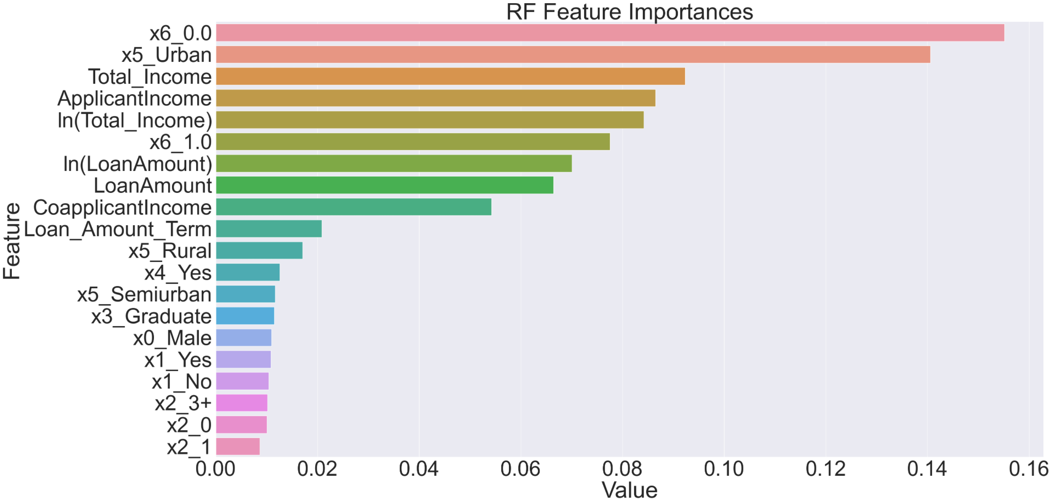
Results
Feature Importances:
RandomForest
Accuracy = 0.85
Insights
No credit history is a deal-breaker
Income is a primary consideration, as expected
Notes:
Top 20 features.
Urban importance could be a combination of factors. Perhaps higher average income, or the model picked up on other behavior.
x1: Married?
x2: Number of dependents
x4: Self-employed?
x6: Credit History?

Slide 9
Challenges
Pipeline debugging
Adding engineered features into pipeline
Notes:
Nik
- Code reusability: code developed during pre-pipeline stage needed a fair amount of rework before using in pipeline

